Slide 1
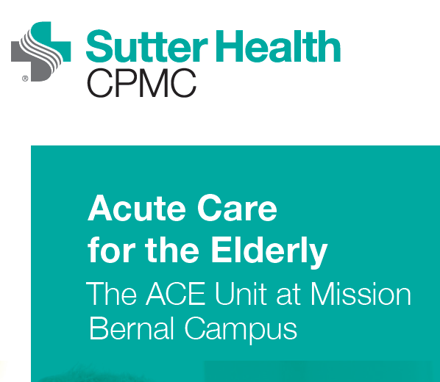

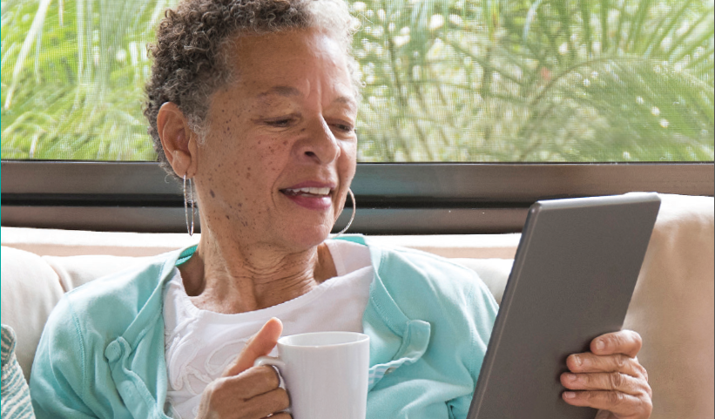
New Acute Care for the Elderly (ACE) Unit at Mission Bernal Campus
Specialized hospital care for older adults
Interdisciplinary geriatric-trained team
Evidence-based care for age 70+
Improved mobility and independence
Patients at risk for loss of function or have delirium, dementia, dehydration, failure to thrive and more

Slide 2
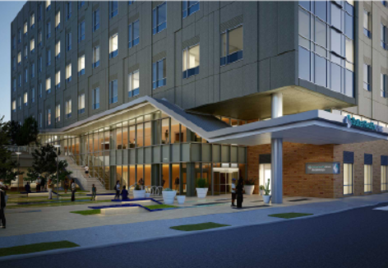
Geriatric ED @ Mission Bernal Campus
First Geriatric care certified ED in SF
Two Dedicated rooms & equipment to Geriatric care
ED physicians & nurses will have specialized training in Geriatric care
New Geriatric ED enhances our current continuum of senior care options at CPMC

Slide 3
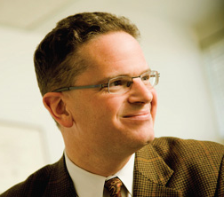
Ari Baron, MD
Dr. Baron received his MD from Tufts University in Boston
Completed his residency & fellowship in Medicine & Hematology and Oncology at UCSF in San Francisco
Currently Chief, Division of Hematology-Oncology @ CPMC
Associate Clinical Professor, Medicine at UCSF
Chair, Science Committee at Sutter CRG
Medical Director, Clinical Oncology Research
Interests are mainly in GI and GU cancers
Published in NEJM, Lancet, JAMA and JCO

Slide 4

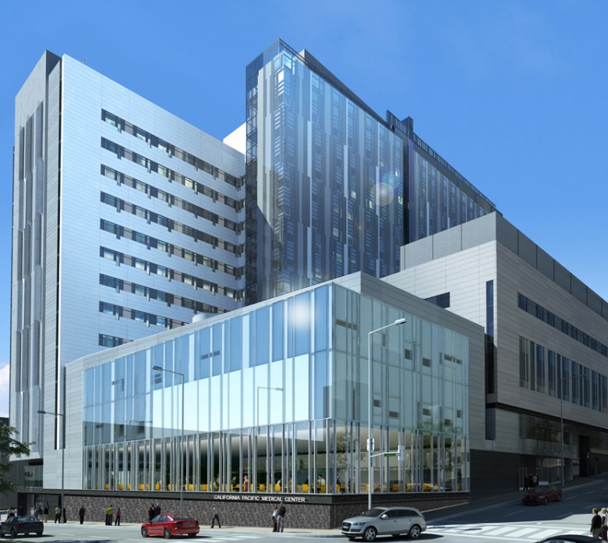
Sutter Safe Care Training Sessions
Between 9/4 to 10/5, Monday – Friday at Davies 3S
Also 4 evening sessions at PAC Enright where dinner is served on 9/13, 9/14, 9/17 and 9/26
2hrs CME credit
Several Malpractice Insurance Carriers to offer discounted Malpractice Insurance Rates (check with your carrier)
Emails with be forthcoming from Dr. Sean Townsend for invitations to register

Slide 5

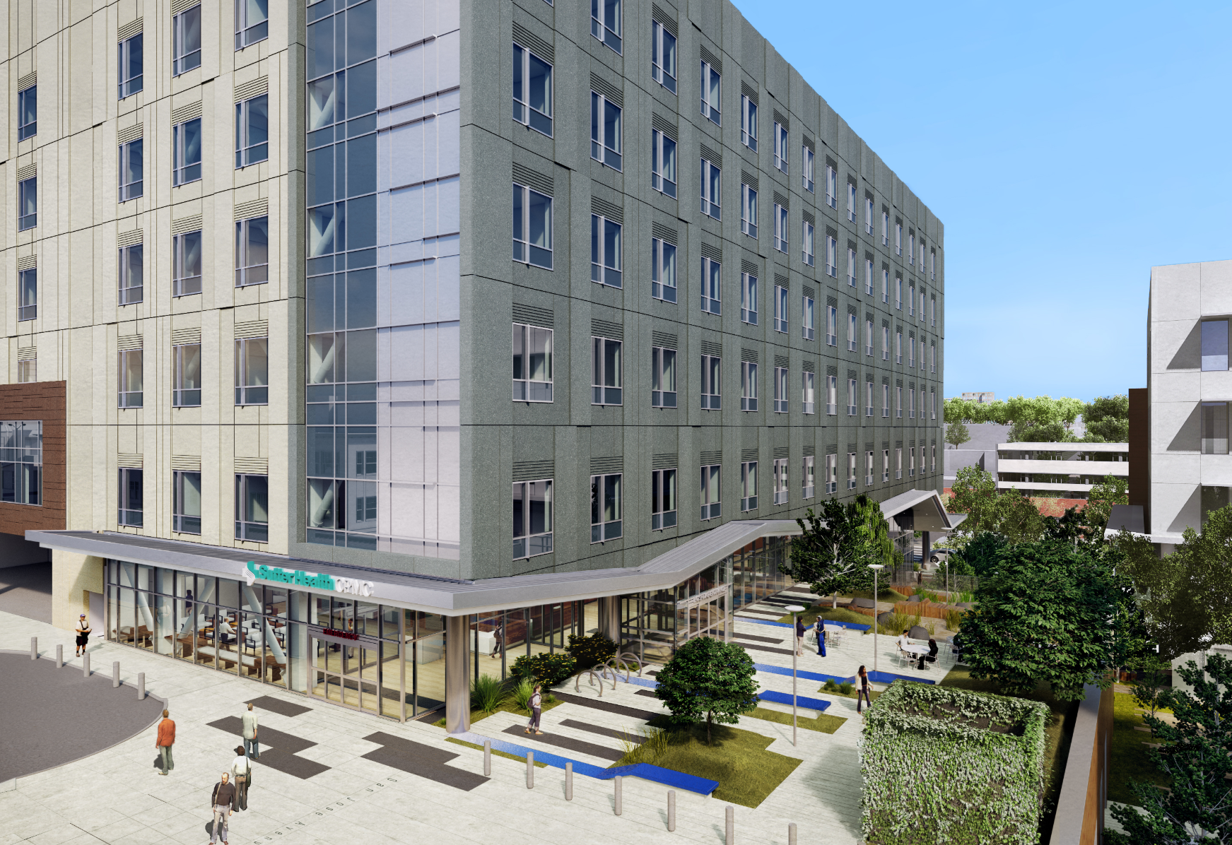
Mission Bernal Hospital
Thanking all our Doctors for a Successful Move.
Over 400 Physicians have completed the Mission Bernal training, tours and received new badges!
Dr. Warren Browner, CEO, Dr. Vernon Giang, CMO and Hamila Kownacki, COO cordially invite you to a special luncheon between 12 Noon and 1PM on:
September 12 at PAC
September 13 at CAL
September 18 at DAVIES
September 20 at MISSION BERNAL CAMPUS
To celebrate a successful move.
Thank You!

